Slide 1

2
Square root

Slide 2
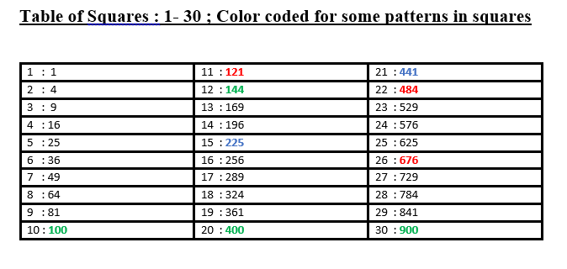

Slide 3
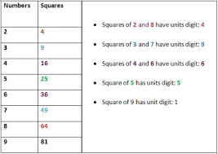

Slide 4

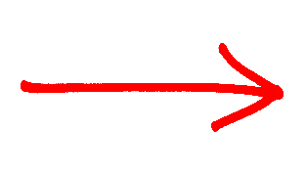
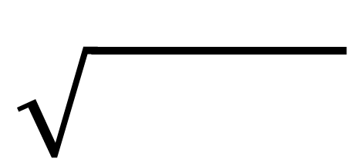
30
25
5
5
30
25
=
_
_
5² =
5² =
25
25
25
36
25
1
4
9
16
25
36
49
64
81
100
121
144
169
196
225
5²
6²
5²
1²
2²
3²
4²
5²
6²
7²
8²
9²
10²
11²
12²
13²
14²
15²
1² =
1
2² =
4
3² =
9
4² =
16
5² =
25
6² =
36
7² =
49
8² =
64
9² =
81
10² =
100

Slide 5

12
96
3
6
12
96
=
_
4 (or) 6
_
4² =
16
3
2
12
25
6² =
36
9
9
16
1
4
9
16
25
36
49
64
81
100
121
144
169
196
225
3²
3²
4²
1²
2²
3²
4²
5²
6²
7²
8²
9²
10²
11²
12²
13²
14²
15²
1² =
1
2² =
4
3² =
9
4² =
16
5² =
25
6² =
36
7² =
49
8² =
64
9² =
81
10² =
100

Slide 6
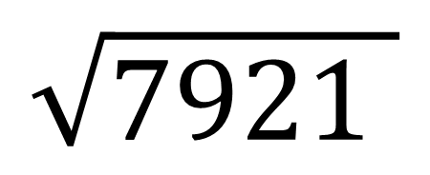
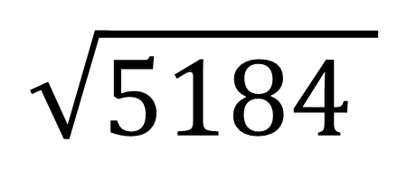
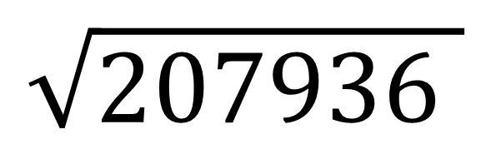
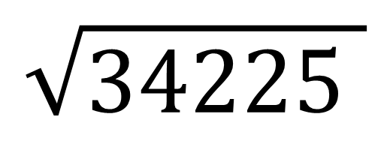
$$\sqrt{5184 }$$
=
72
$$\sqrt{7921 }$$
=
89
$$\sqrt{34225 }$$
=
185
$$\sqrt{207936 }$$
=
456

Slide 7
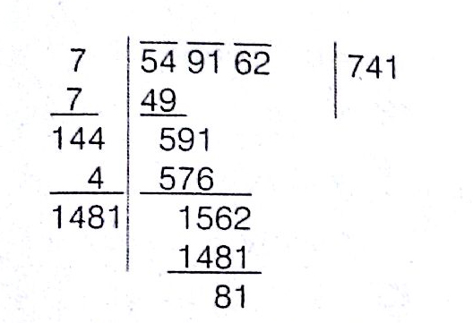

Slide 8
3
Cube root

Slide 9
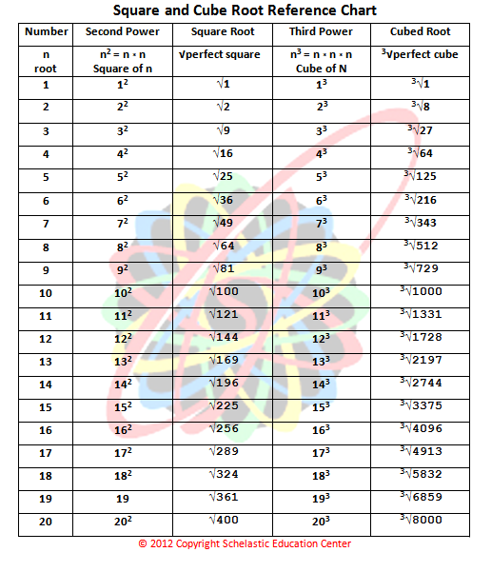

Slide 10
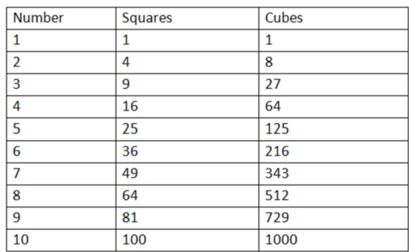

Slide 11

$$\sqrt[3]{ }$$
4
_
110
592
=
_
8
110
592
64
125
64
1
8
27
64
125
216
343
512
729
1000
1331
1728
169
196
225
8³ =
512
8³ =
512
4³
4³
5³
1³
2³
3³
4³
5³
6³
7³
8³
9³
10³
11³
12³
13³
14³
15³
1³ =
1
2³ =
8
3³ =
27
4³ =
64
5³ =
125
6³ =
216
7³ =
343
8³ =
512
9³ =
729
10³ =
1000

Slide 12
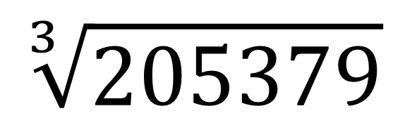
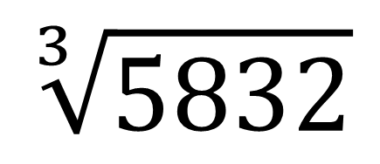
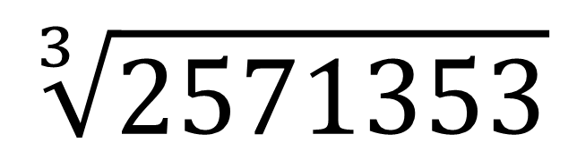
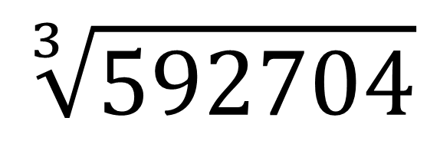
$$\sqrt[3]{5832}$$
=
18
$$\sqrt[3]{205379}$$
=
59
$$\sqrt[3]{592704}$$
=
84
$$\sqrt[3]{2571353}$$
=
137

Slide 13
THANK YOU
IYAPPAN M

